Slide 1

DATA SCRAPING USING BLUE PRISM
Project Guide : Dr. T. Prem Jocob
Name of the Student : Ms. Sakthi Kuhan
Register Number : 39110878

Slide 2

Presentation outline
Certificate
Introduction
Objectives
System Architecture
Ideation Map
Project Implementation
Methodology
Result
Conclusion
References

Slide 3
Certificate

Slide 4
Introduction
The Blue Prism is one of the leading Robotic Process Automation(RPA) tool is used to automate mundane tasks such that could operate without any manual interventions.
It enables the business process to be agile, cost-effective and increases work efficiency and accuracy.
Data scraping is the process of collecting structured web data in an automated fashion. It is also called web data extraction. Some of the main use cases of web scraping include price monitoring, price intelligence news monitoring,lead generation and market research among many others.
With the help of the Blue Prism RPA tool, this project has been carried out to extract the Samsung phones data from the Flipkart by auto launching the website.

Slide 5
Objectives
Aim :
To extract Samsung mobile phone data such as Samsung model, price and rating from a website - Flipkart using Blue Prism Robotic Process Automation tool.
The Blue Prism tool offers a flowchart with drag and drop features to automate each step of the processes.
The operations include,
Auto Launch the website [Flipkart]
Extract the Data [Samsung model, Price, Rate ]
Store the data extracted.
Scope :
Blue Prism RPA tool facilitates the digital workers on extracting the data from any stage viably and precisely without manual intervention. It decrease the valuable labour to physically visit every website and gather the data.

Slide 6
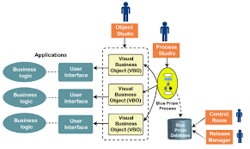
System Architecture
Blue Prism Architecture

Slide 7



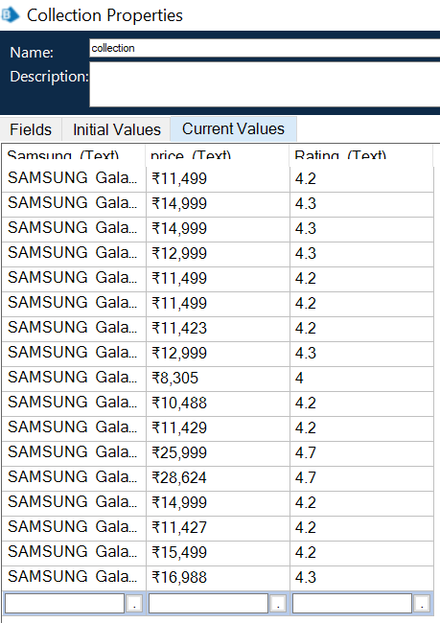
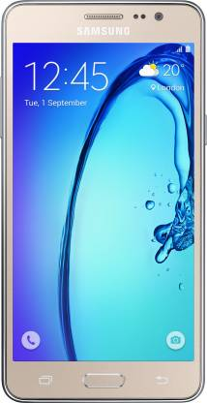
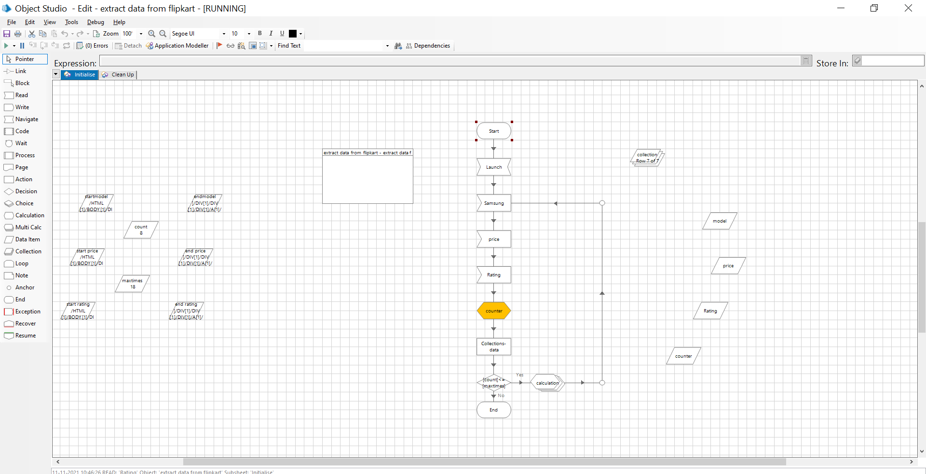
Ideation Map
Launch
RPA
Launch
Read
Extract
Process
Dynamically

Slide 8
Project Implementation
Hardware Requirements
Internet connection to download and activate
Administration access to install and run Blue Prism
Minimum 10GB free disk space
Windows 8.1 or 10 (64-bit version only)
Minimum System Requirements to run Office Excel 2013, your computer needs to
meet the following minimum hardware requirements:
a. 500 Megahertz (MHz)
b. 256 Megahertz (MB) RAM
c. 1.5 Gigabytes (GB) available space
d. 1024x768 or Higher resolution monitor

Slide 9
Project Implementation
Software Requirements
Operating System : Windows 10
Installation and Setup Guide for Blue Prism
Installation and Setup Guide for MS Excel
Blue Prism Version: 7
Blue Prism License File
Blue Prism Installation Software 64 bit
MS Excel

Slide 10


Project Implementation
Modules
- Action
- Start and End
- Decision
- Navigate
- Read
- Multiple Calculation
- Anchor
- Data Item
- Link
- Calculation
- Collection

Slide 11
Project Implementation
Scheme of Work
Installation of Blue Prism
Auto –launching the Website
Reading the Data
Setting the Dynamic Path
Calculation
Running the flowchart
Result

Slide 12
Methodology
Algorithm
Step 1 : Start the process
Step 2 : Open Blue prism software. Create a new object from Studio tab using Create
Object . Give object name and click finish.
Step 3 : Double click on the newly created object and it will open the object studio,
Step 4 : Rename the page.
Step 5 : Click on Application Modeller and keep the application name unchanged.
Click Next and select Browser-Based Application and click Next.
Step 6 : Select a browser that is launched from an executable file and click Next.
Now provide the browser exe file path and go Next.
Step 7 : Enter the URL you wish to open and go Next. Now, leave the default options
as it is and keep on clicking Next, finally click Finish.
Step 8 : Application Modeller which can be launched now to open the desired web
url.Give attach
Step 9 :In application modeller, Add an element Samsung . Identify and highlight the
Samsung model.
Step 10 : In application modeller,Add an element Price. Identify and highlight the
Samsung Price.

Slide 13
Methodology
Step 11 :In application modeller, Add an element Rating. Identify and highlight the
Samsung Rating.
Step 12 : Add Navigate, add flipkart ecommerce as an element. Rename it as
launch.
Step 13 : Add Read, add an element Samsung. Choose data as get current value.
Step 14 : Add Read, add an element Price. Choose data as get current value.
Step 15 : Add Read, add an element Rating. Choose data as get current value.
Step 16 : Add Collection and add 3 rows such as Samsung, Price, Rating with data
type as text.
Step 17 : Drag and drop collection.samsung in Samsung Read Store in .
Step 18 : Drag and drop collection.price in Price Read Store in .
Step 19 : Drag and drop collection.rating in Rating Read Store in .
Step 20 : Add 6 data items.
Step 21 : Name those data items as start model, end model, start price, end price,
star rating and end rating.

Slide 14
Methodology
Step 22 : Go to Application Modeller. Identify and highlight the first mobile data such
as model, price and rating. Copy the path in Notepad.
Step 23 : Go to Application Modeller. Identify and highlight the second mobile data
such as model, price and rating. Copy the path in Notepad.
Step 24 : Compare the two mobile paths.
Step 25 : Give space before the intermediate
Step 26 : Paste the start path and end path in the respective data items.
Step 27 : Go to Application Modeller and change the path as dynamic for all
element by identifying the first mobile path.
Step 28 : Add the data items count, maxtimes and keep it in between the start paths
and end paths.
Step 29 : Give count initial value as 2 since the mobile starting from the number 2
give data type as numbers.
Step 30 : Give maxtimes initial value as 18 as wishing to extract data for 18 mobiles.
Give data type as number.
Step 31 : Create a data item counter. Add calculation, give the calculation as
[count]+1 and name it as counter.

Slide 15
Methodology
Step 32 : Add action , choose business object as collection. Give the expression as
"collection" name it as collections data.
Step 33 : Add decision [count]<=[maxtimes]
Step 34 : Create data item model, price, rating to perform multiple calculation .
Step 35 : Add multiple calculation.
Step 36 : Add 3 rows.
Step 37 : Drag and drop [model] [price] [rating] in expression.
Step 38 : Drag and drop collection.samsung,collection.price, collection.rating row by
row in Store in.
Step 39 : Link start launch, samsung , price, rating, counter, collection-data,
[counter]<=maxtimes, calculation,anchor to samsung.
Step 40 : Go to start. Set Next stage.
Step 41 : Run the Flowchart.
Step 42 : Get the Output data in collection.
Step 43 : Stop the Process.

Slide 16
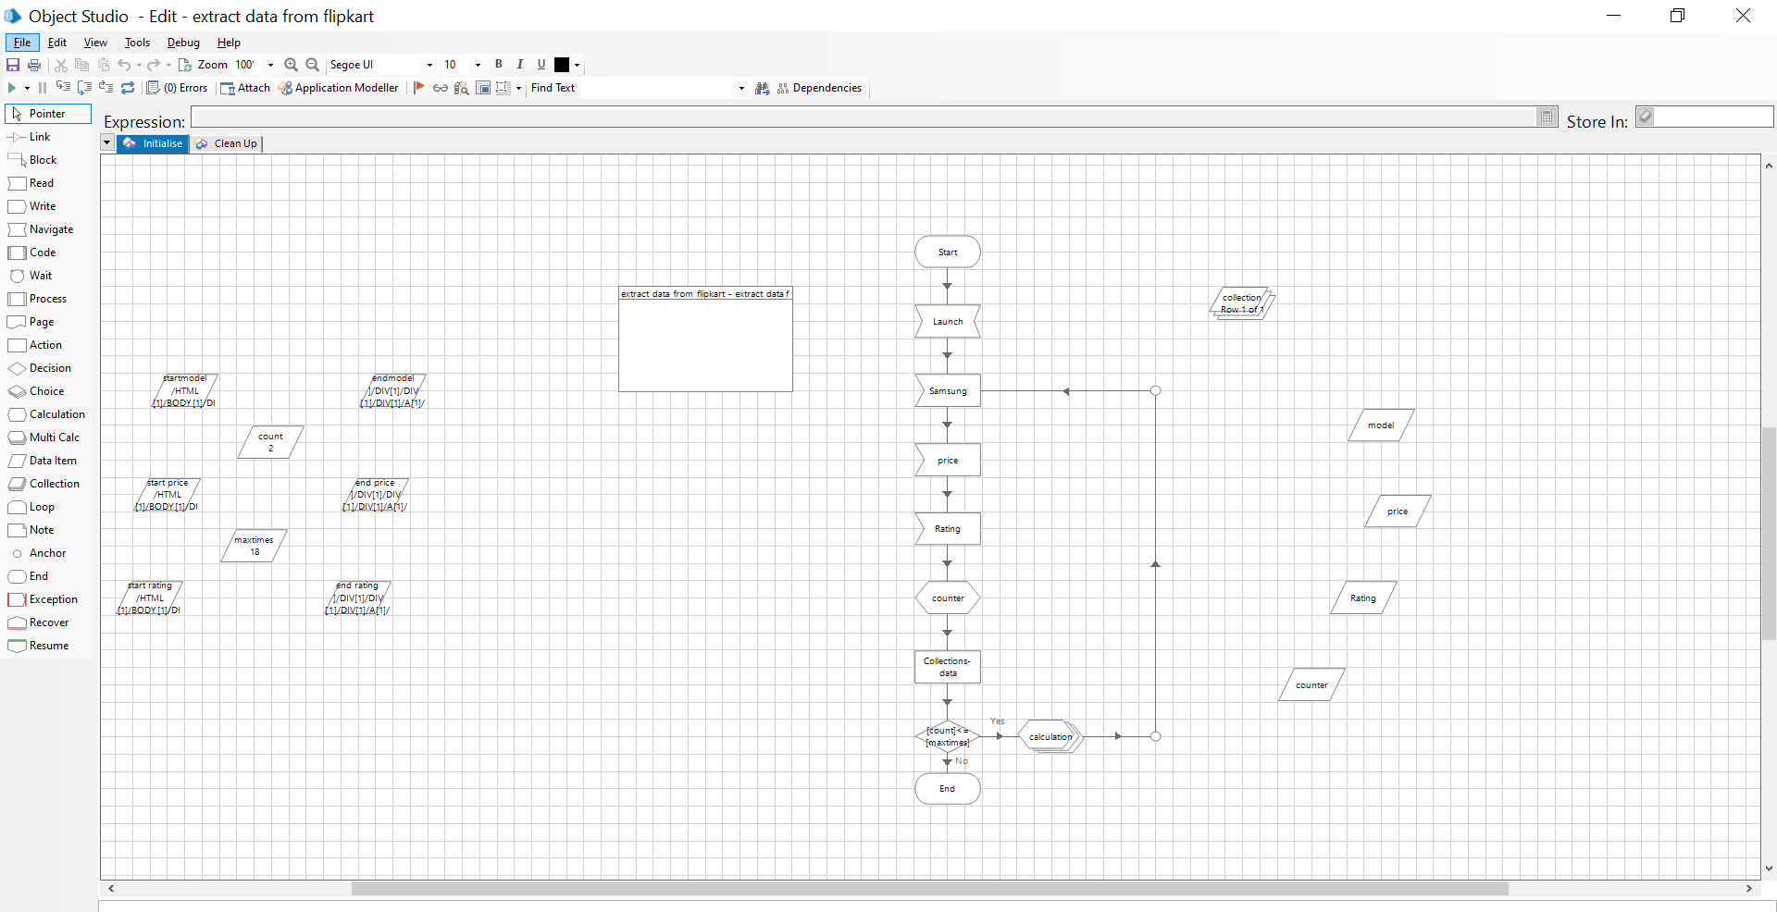
Result
Object Studio’s Flow before Execution

Slide 17
Result
Object Studio’s Flow during Execution

Slide 18
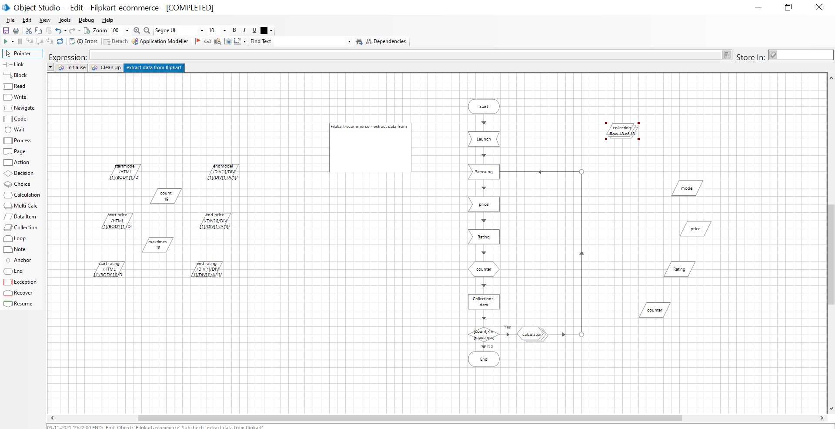
Result
Object Studio’s Flow after Execution

Slide 19
Result
Output Extracted from the Flipkart Website

Slide 20
Conclusion
By using Blue Prism Robotic Process Automation tool, Samsung mobile phone data was collected dynamically from Flipkart which helps the Digital workers, end-user and the organization according to their needs.
The future of Web scraping is to be sure brilliant and it will turn out to be increasingly more fundamental for each business with the progression of time.

Slide 21
References
1. "Search Engine History.com". Search Engine History. Retrieved November 26,
2019.
2. ^ Song, Ruihua; Microsoft Research (Sep 14, 2007). "Joint Optimization of
Wrapper Generation and Template Detection" (PDF). The 13th International
Conference on Knowledge Discovery and Data Mining: 894.
doi:10.1145/1281192.1281287. ISBN 9781595936097. S2CID 833565. Archived from
the original (PDF) on October 11, 2016
3. ^ Semantic annotation based web scraping
4. ^ Roush, Wade (2012-07-25). "Diffbot Is Using Computer Vision to Reinvent the
Semantic Web". www.xconomy.com. Retrieved 2013-03-15.
5. ^ "FAQ about linking – Are website terms of use binding contracts?".
www.chillingeffects.org. 2007-08-20. Archived from the original on 2002-03-08.
Retrieved 2007-08-20.

Slide 22
References
https://youtu.be/iVYtNdCYgFo
https://en.wikipedia.org/wiki/Web_scraping
https://it-s.com/the-future-of-web-scraping-services/
https://www.webharvy.com/articles/web-scraper-use-cases.html
https://librarycarpentry.org/lc-webscraping/05-conclusion/index.html
https://www.promptcloud.com/blog/emerging-applications-of-web-scrapingtechnology/
https://www.xbyte.io/the-history-of-web-scraping.php
https://towardsdatascience.com/https-medium-com-hiren787-patel-web-scrapingapplications-
a6f370d316f4

Slide 23
THANK YOU

